Slide 1
Secure and Efficient Image Delivery using Cloud Technologies

Slide 2
Abstract:
Now-a-days the use of digital Images has become a very common way of sharing Information, be it from personal holiday Images to confidential Intelligence reports. As such, secure and efficient sharing of such data is one of the major problem in this digital world. There are so many methods available to compress data like ZIP, GZIP, RAR etc., but these apply on general data and are not really optimized for Image compression, One way to solve this is by using Image Compression techniques using Huffman, Run-length coding etc., each providing a different level of compression efficiency for a given Image sample. This project tries to solve this issue by using the well-established and highly secure encryption standard, AES-256 in combination with the RSA key exchange mechanism, which can be used to exchange the AES encrypted keys with the receiver. The asymmetric public and private keys generated by RSA makes it harder for intruders to steal the keys. All put together with an User Interface for easy access to the service can be viable solution to the problem

Slide 3
Objective:
To create Fast, Secure and Efficient way of Image Transmission for effective distribution of Image Payloads to the clients using Cloud Technologies

Slide 4
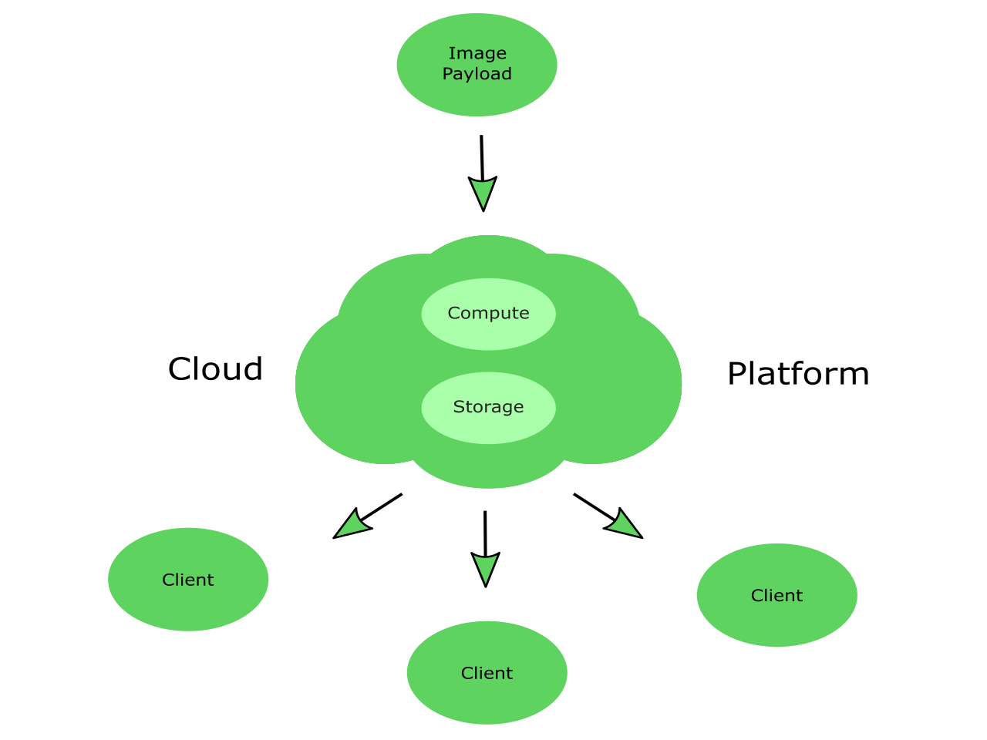
Image payload Distribution

Slide 5
Procedure:
This process involves Five Stages
Image Compression
Image Encryption
Encrypted Key sharing
Image Decryption
Image Decompression

Slide 6
Applications:
Fast and secure information transmission in the military operations.
Forwarding patients medical reports from one hospital to other hospitals.
Fast and secure image Delivery in social media apps like facebook,instagram,whatsapp etc..

Slide 7
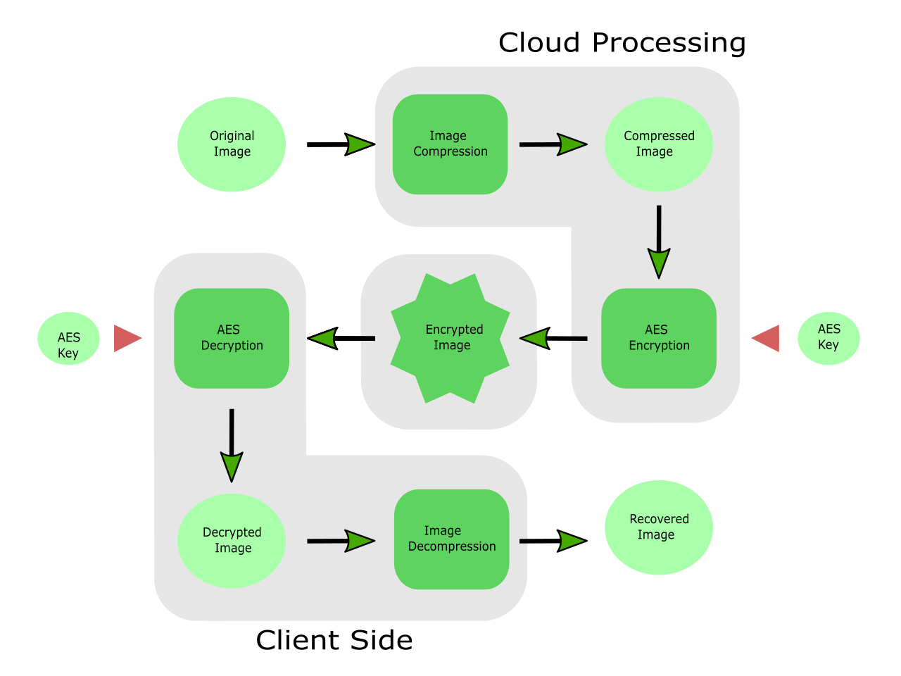

Slide 8
RSA Key Exchange Mechanism
The problem of sharing the “AES key” required to decrypt the encrypted Image from server to client is solved by using the “RSA Key Exchange Mechanism”.
The Client generates the RSA Public and Private keys, shares the “Public Key” with the cloud server, the server encrypts the “AES keys” with the “Public Key” and sends the “AES Key” to the client
The public key can not be used to decrypt the encrypted “AES Key”, and only the Client who generated the Key Pair can decrypt the “AES Key”, thus preventing Intruders from stealing the “AES Key”

Slide 9
Features:
Images are Compressed to minimize Storage Space and reduce Transmission Bandwidth
AES-256 Encryption standard is used for encryption of Images to provide better Security
RSA Key Exchange Mechanism is used to securely exchange the AES keys between Sender and Receiver
Amazon Web Services (AWS) is used as the Cloud Platform, which offers Highly Scalable Compute Power and Storage.

Slide 10
References:
[1] "Biclique Cryptanalysis of the Full AES" (PDF). Archived from the original (PDF) on March 6, 2016. Retrieved May 1, 2019.
[2] Huffman, D. (1952). "A Method for the Construction of Minimum- Redundancy Codes" (PDF). Proceedings of the IRE. 40 (9): 1098– 1101. doi:10.1109/JRPROC.1952.273898.
[3] "Distributed Team Cracks Hidden Message in RSA's 56-Bit RC5 Secret-Key Challenge". October 22, 1997. Archived from the original on September 29, 2011. Retrieved February 22, 2009.
[4] "What is Cloud Computing?". Amazon Web Services. 2013-03-19. Retrieved 2013-03-20.

Slide 11


